Slide 1


Get To Git
Session 2
Eyad Ahmed Farouk

Slide 2
Recap

Slide 3
Recap
Working Dir
Staging area
Repository
File 1
File 2
File 3

Slide 4
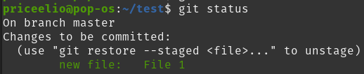
Recap
Working Dir
Staging area
Repository
File 1
File 2
File 3

Slide 5
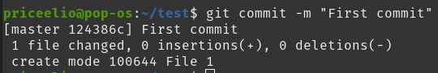
Recap
Working Dir
Staging area
Repository
File 1
File 2
File 3

Slide 6
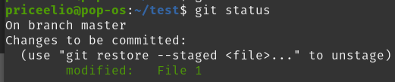
Recap
Working Dir
Staging area
Repository
File 1
File 2
File 3

Slide 7
Recap
Working Dir
Staging area
Repository
File 1
File 2
File 3

Slide 8
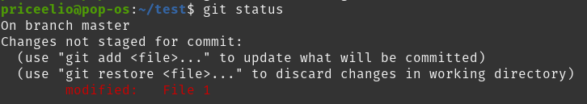
Recap
Working Dir
Staging area
Repository
File 1
File 2
File 3

Slide 9
Recap
Working Dir
Staging area
Repository
File 1
File 2
File 3

Slide 10
Recap
Working Dir
Staging area
Repository
File 1
File 2
File 3

Slide 11
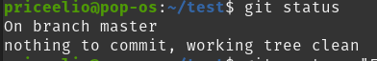
Recap
Working Dir
Staging area
Repository
File 2
File 3

Slide 12
Agenda
Branches
02
Contribution
01
1 Branches
2 Merging
3 Remotes
4 Pull requests
1 Contribution
2 How to find issues?

Slide 13
Part One:
Branches

Slide 14
Branches

Slide 15
How Git stores Commit
Master branch:
This is the default branch in Git
Note: GitHub calls the default branch main.
Master
1- Eyad
1

Slide 16
How Git stores Commit
Master branch:
This is the default branch in Git
Note: GitHub calls the default branch main.
1- Eyad
2- 20
Master
1
2

Slide 17
How Git stores Commit
Master branch:
This is the default branch in Git
Note: GitHub calls the default branch main.
1- Eyad
2- 20
3- CS
Master
1
2
3

Slide 18
How Git stores Commit
Master branch:
This is the default branch in Git
Note: GitHub calls the default branch main.
1- Eyad
2- 20
3- CS
4- 3
Master
1
2
3
4

Slide 19
Creating New Branch
When creating new branch, Git creates new pointer that points to start of this branch.
Git moves this pointer forward every time you commit to the branch.
To create a new branch:
git branch branchName
To create a new branch starting from a specific commit:
git branch branchName [startPoint]

Slide 20
Switching to Another Branch
To switch to another branch:
git switch branchName
To create and switch at the same time :
git switch -c branchName

Slide 21
Switching and Branching
HEAD
Master
9d2d2
23ds2
3sa2d
23sa2

Slide 22
Switching and Branching
HEAD
Master
9d2d2
23ds2
3sa2d
23sa2
Test

Slide 23
Switching and Branching
Master
9d2d2
23ds2
3sa2d
23sa2
Test
HEAD

Slide 24

Git Checkout
checkout is Git’s swiss army knife – it has many seemingly unrelated uses.
In Git version 2, checkout functionality was split into two commands: switch and restore
Learn more here and here!
Functionality | Using checkout | Using switch/restore
Switch to a branch | git checkout branchName | git switch branchName
Untrack modified file | git checkout -- file | git restore file
Creating a branch and switching to it | git checkout -b branchName [startpoint] | git switch -c branchName [startpoint]

Slide 25
Commit History
To show commit history for the a given branch:
git log branchName
To show all of the branches:
git log --all

Slide 26
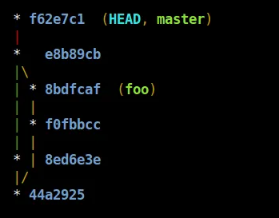
Commit History
To show all of the branches tree path, add --graph
git log --all --graph --oneline

Slide 27
Merging

Slide 28
Merging Types
01
02
03
Three Way
Merge
Basic Merging Conflicts
Fast Forward

Slide 29
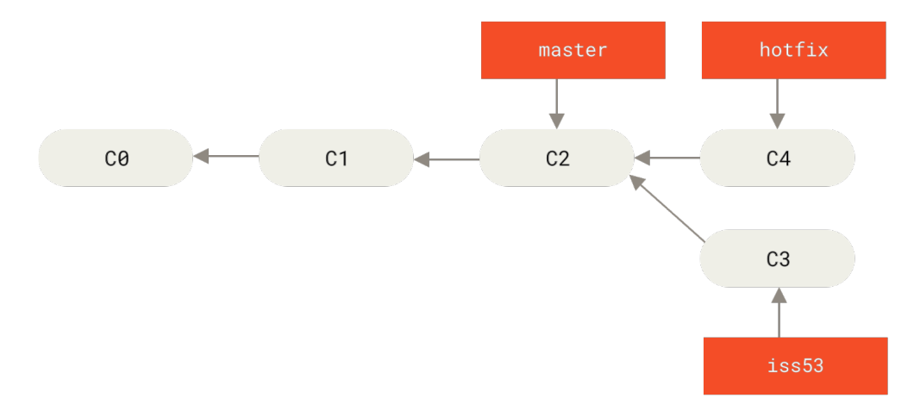
Fast Forward
Fast forward merging is to move the master pointer forward to the last commit in the branch that you merge.
Command :
git merge branchName

Slide 30
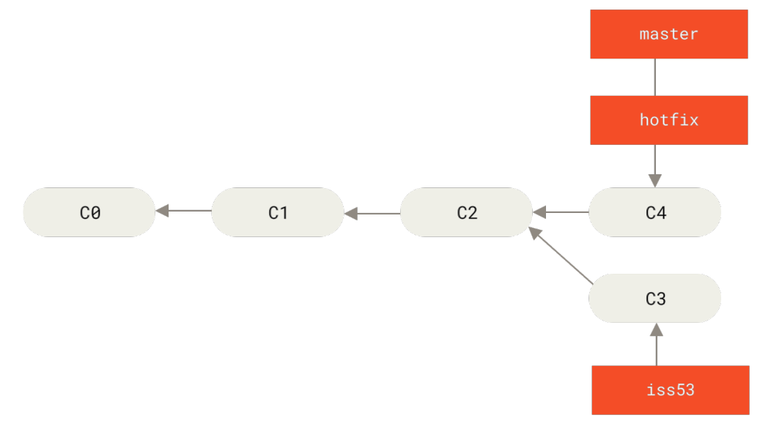
Fast Forward
Now hotfix branch and master point to commit C4

Slide 31
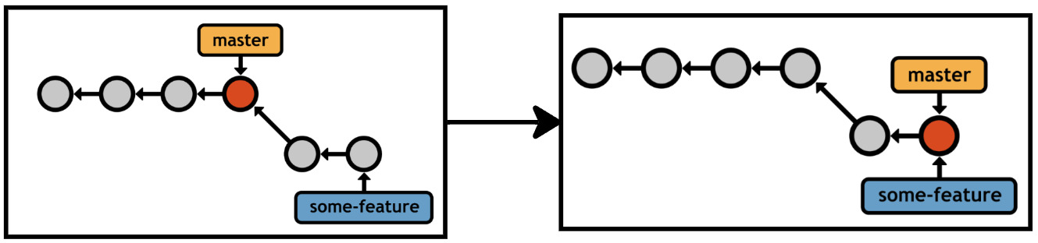
Fast Forward

Slide 32
Fast Forward
Master
C1
C2
C3
C4
C5
Master
eyad
1- Eyad
2- 20
3- 3
4- CS
1- Eyad
2- 20
3- 3
4- CS
5- Extrovert
eyad
HEAD

Slide 33
Fast Forward
Master
C1
C2
C3
C4
C5
eyad
HEAD

Slide 34
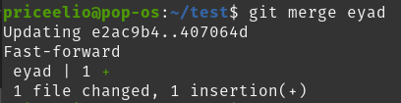
Fast Forward
HEAD
Master
C1
C2
C3
C4
C5
eyad

Slide 35
Fast Forward
HEAD
Master
C1
C2
C3
C4
C5
eyad

Slide 36
Fast Forward
HEAD
Master
C1
C2
C3
C4
C5
What will happen??
eyad
C6
Test

Slide 37
Three Way Merge
It happens when two branches have diverged and both have their own unique commits since the common ancestor.

Slide 38
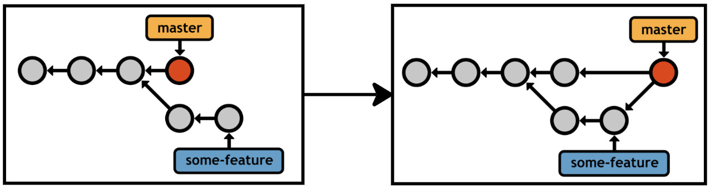
Fast-Forward vs Three Way Merge
Fast-Forward
Three Way Merge

Slide 39
Three Way Merge
It’s called three ways, as Git does three things
‌‌Finding the common ancestor of the two branches. This ancestor is called “merge base.”
Finding the last two snapshots.
Creating new commit that points to the last two snapshots

Slide 40
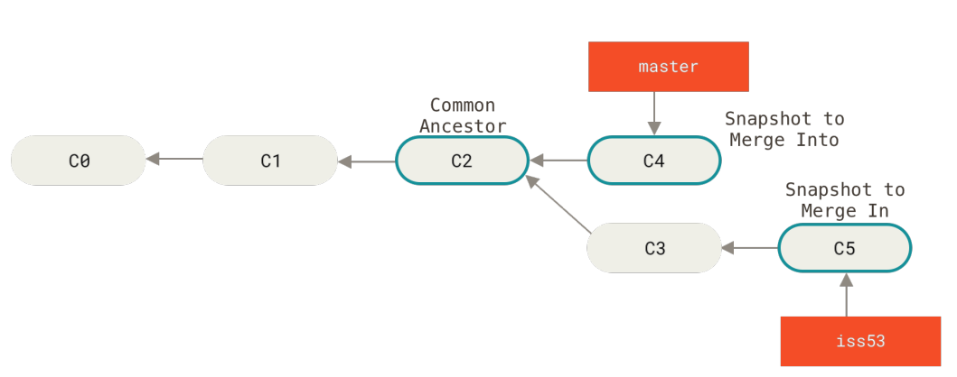
Three Way Merge

Slide 41
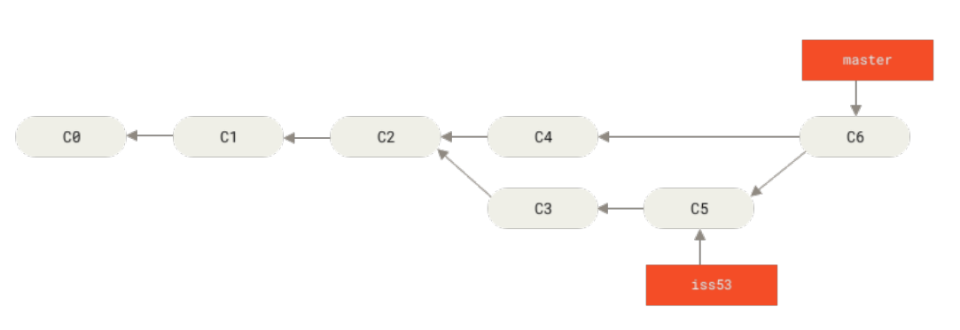
Three Way Merge

Slide 42
Three Way Merge
HEAD
Master
C1
C2
C3
C4
C5
Master
Test
1- Eyad
2- 20
3- 3
4- CS
6- Adel
7- 19
8- 3
9- SC
C5
Test

Slide 43
Three Way Merge
HEAD
Master
C1
C2
C3
C4
C5
C5
Test

Slide 44
Three Way Merge
HEAD
Master
C2
C3
C4
C5
C6
C5
Test

Slide 45
Basic Merging Conflict
If you changed the same part of the same file in the two branches you’re merging, Git won’t be able to merge them cleanly. It will leave this task for you!

Slide 46
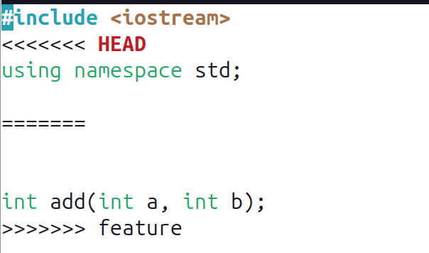
How Does Git Mark Conflicts?
Git adds standard conflict resolution markers to the files that have conflicts, so you can open them manually and resolve those conflicts.

Slide 47
How To Solve The Conflict?
First,
Choose the part that you want to save in your new version or merge between them.
Second,
Remove conflict resolution markers
Finally,
Commits your files.

Slide 48
Three Way Merge With Conflict
HEAD
Master
C1
C2
C3
C4
C5
Master
Test
1- Eyad
2- 20
3- 3
4- CS
1- Adel
2- 19
3- 3
4- SC
C5
Test

Slide 49
Three Way Merge With Conflict
HEAD
Master
C1
C2
C3
C4
C5
Conflict, Fix it before continuing
Master
Test
1- Eyad
2- 20
3- 3
4- CS
1- Adel
2- 19
3- 3
4- SC
C5
Test

Slide 50
Three Way Merge With Conflict
<<<<<<HEAD
Eyad
20
3
CS
=========
Adel
19
3
SC
>>>>>Test
HEAD
Master
C1
C2
C3
C4
C5
Master
Test
1- Eyad
2- 20
3- 3
4- CS
1- Adel
2- 19
3- 3
4- SC
C5
Test

Slide 51
Three Way Merge With Conflict
Eyad’s Info:
Eyad
20
3
CS
Adel’s Info:
Adel
19
3
SC
HEAD
Master
C1
C2
C3
C4
C5
Master
Test
1- Eyad
2- 20
3- 3
4- CS
1- Adel
2- 19
3- 3
4- SC
C5
Test

Slide 52
Three Way Merge With Conflict
Eyad’s Info:
Eyad
20
3
CS
Adel’s Info:
Adel
19
3
SC
HEAD
Master
C2
C3
C4
C5
C6
C5
Test

Slide 53
Git Branch <options>:
-v
-d <branch>
-D <branch>
--merged
--no-merged
It can be used to view branches
view every commit that branch points to
delete merged branch
delete not merged branch
view branched that have merged with current branch
view branched that have not merged with current branch

Slide 54
Practice
Master
Add
Sub
Better Sub
int add(){
}
int sub(){
}
int add(){
return 1 + 2;
}
int sub(){
}
int add(){
}
int sub(){
return 2 - 1;
}
int add(){
}
int sub(int a, int b){
return a - b;
}

Slide 55
Practice
Better sub
Sub
Add
HEAD
Master
C1

Slide 56
Practice
Sub
C3
HEAD
Master
Add
C1
C2
Better sub
C4

Slide 57
Practice
Sub
C3
Master
HEAD
Add
C1
C2
Better sub
C4

Slide 58
Practice
Sub
C3
Master
HEAD
Add
C5
C1
C2
Better sub
C4

Slide 59
Practice
Sub
C3
Master
HEAD
Add
Conflict, Fix it before continuing
C5
C1
C2
Better sub
C4

Slide 60
Practice
Sub
C3
Master
HEAD
Add
C5
C6
C1
C2
Better sub
C4

Slide 61
Hands on

Slide 62
Create a "project” directory and navigate inside it.
Add a README.txt file in it and write your name in it
Initalize a git repository.
Create two branches, iss1 and feat.
In branch feat, create “CONTRIBUTING.md” file
In branch iss1, modify your name in to be in capital and commit changes
In master branch, replace first line with “Project Features.” and commit changes
Merge feat in master
Merge iss1 in master (We want to keep all changes)

Slide 63
Break🎉
15 minutes

Slide 64
Remotes

Slide 65
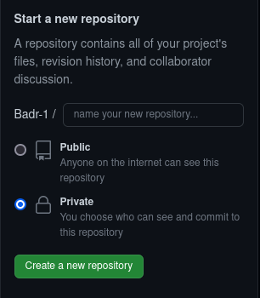
Creating New Repository on GitHub
c

Slide 66
Creating New Repository on GitHub
c
echo "# demo" >> README.md
git init
git add README.md
git commit -m "First commit"
git branch -M main
git remote add origin URL
git push -u origin main

Slide 67
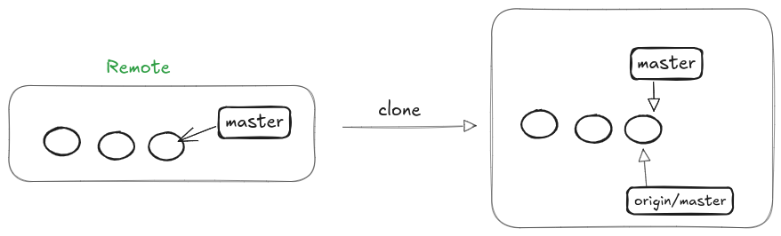
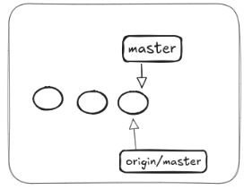
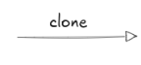
Cloning Remote Repo
c
git clone url <dir-name>
It creates a local repo from master/main branch of remote repo
To see remotes run : git remote <options>

Slide 68
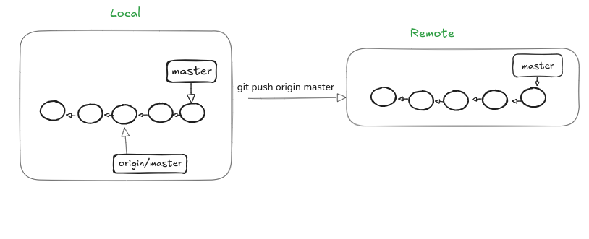
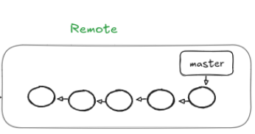
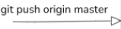
git push <remote-name> <branch-name>

Slide 69
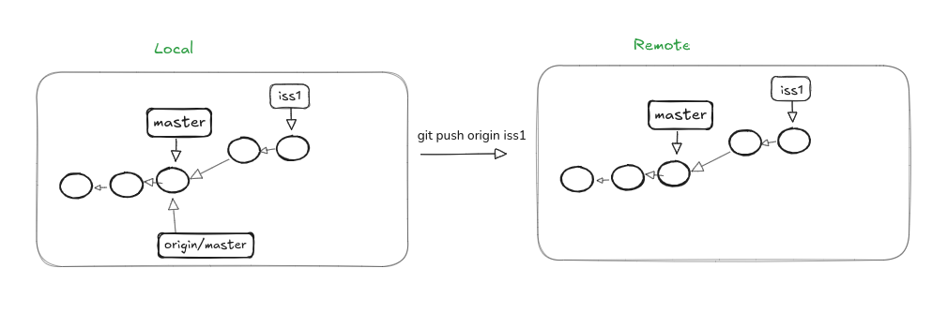
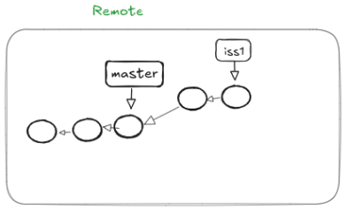
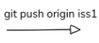
git push <remote-name> <branch-name>

Slide 70
Get Updates
git fetch <remote> <branch>
git pull <remote> <branch>
it get updated to your repo but it doesn't merge in master/main branch
to merge changes use : `git merge`
it's good to review some updates before merging it
it fetch and merge at the same time

Slide 71
Tracking remote branch
git checkout --track remote/branch
Creates new local branch
Link it with the remote branch
To see what tracking branches you have set up:
git branch -vv

Slide 72
RECAP
Branches
Merging
Remotes
Fetch / Pull
Push

Slide 73
Pull Request

Slide 74
Pull Request
A pull request is a proposal to merge a set of changes from one branch into another.
In a pull request, collaborators can review and discuss the proposed set of changes before they integrate them into the main codebase.
Pull requests display the differences, or diffs, between the content in the source branch and the content in the target branch.

Slide 75
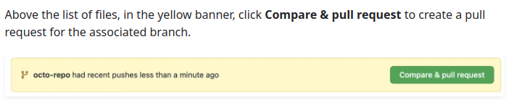
Creating a Pull Request
How to create a pull request

Slide 76
Updating a Pull Request
When creating a Pull Request in branch, there is link that created between this PR and your branch
Therefore, all you have to do is make changes in the branch and push it there, and it will synchronize with Pr.

Slide 77
Fork and Pull Request
When user doesn’t have access to remote repo of the project
It is primarily similar to open source projects.
It also helps to maintain the cleanliness and safety of the main project.
Use someone else's project as a starting point for your own idea.
So now you make a pull request from branch in forked repo to branch in original repo
Fork a repository

Slide 78
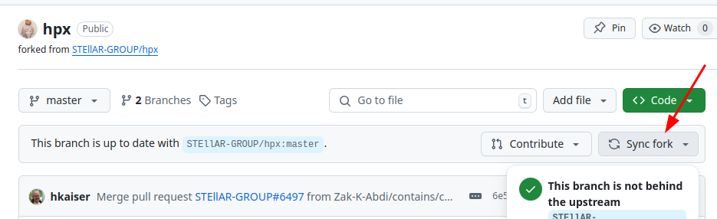
Updating Forked Repository

Slide 79
Part Two:
Contribution

Slide 80
Last Session
What Is Open Source?
Google Summer of Code
Why Contribute?

Slide 81
Steps To Contribute
Read documents, contributing guidelines and README files
01
02
Fork and make a change
Finding an issue or open one
Create your pull request
03
04

Slide 82
Choosing An Issue
What is required?
01
02
Is it available to work on?
Is there someone working on it?
03

Slide 83
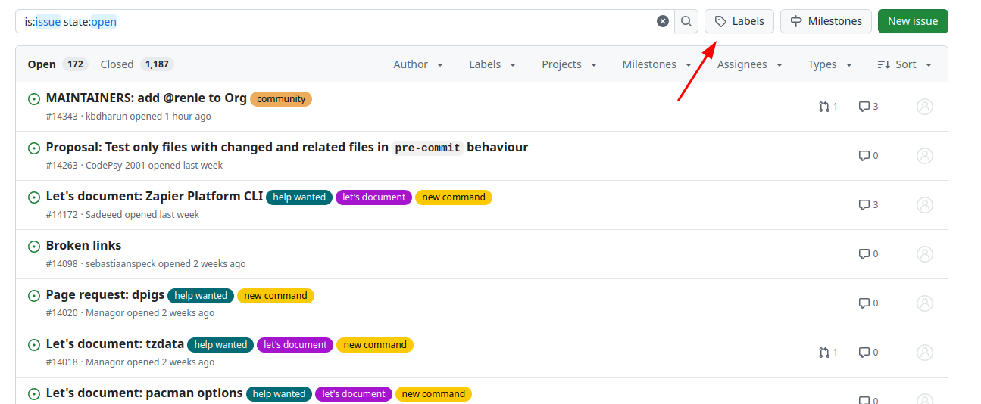

Slide 84
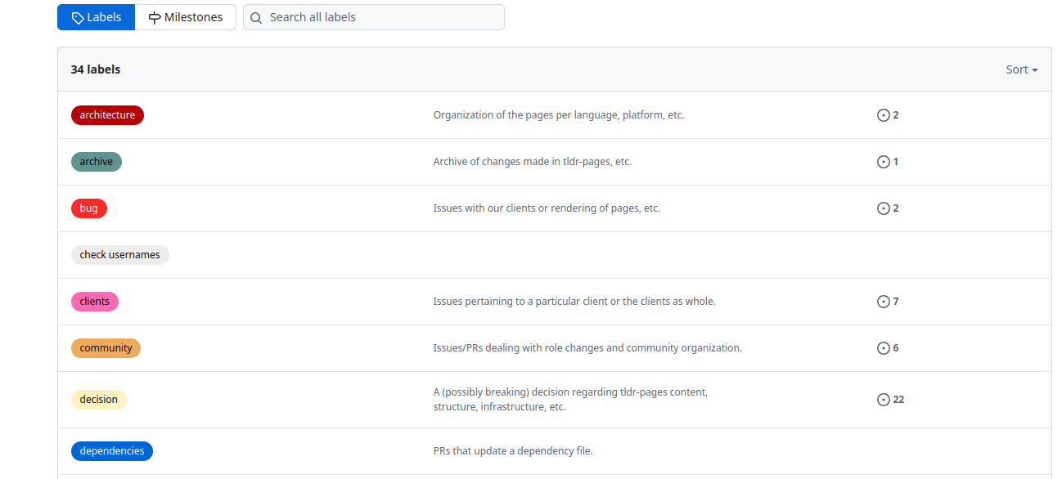

Slide 85
Let’s create our first contribution 🎉

Slide 86
Resources
ProGit
Get To Git Playlist
Livestream about open source by Abdelrahaman Awad
More about GSoC (Google Summer of Code)

Slide 87
— Jack William Bell
It is easy to shoot your foot off with Git, but also easy to revert to a previous foot and merge it with your current leg."

Slide 88
Thank You!

